Slide 1

Twitter Insights: How we reached business propositions from the complain central of social media
Team – A (Tweets)

Slide 2
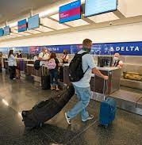
Mission statement
At Freefall Airline here, we want to explore topmost negative reviews from customers and do deep learning and compare with other US Airlines, Identify problem and propose optimized solution to bring back our Airline back in business with happy customers.

Slide 3
Current Market Opportunities
Market gap
All Airlines are struggling to retain customers because of negative review trends
Customers
63% of US costumers tweeted are unhappy with the airline

Slide 4
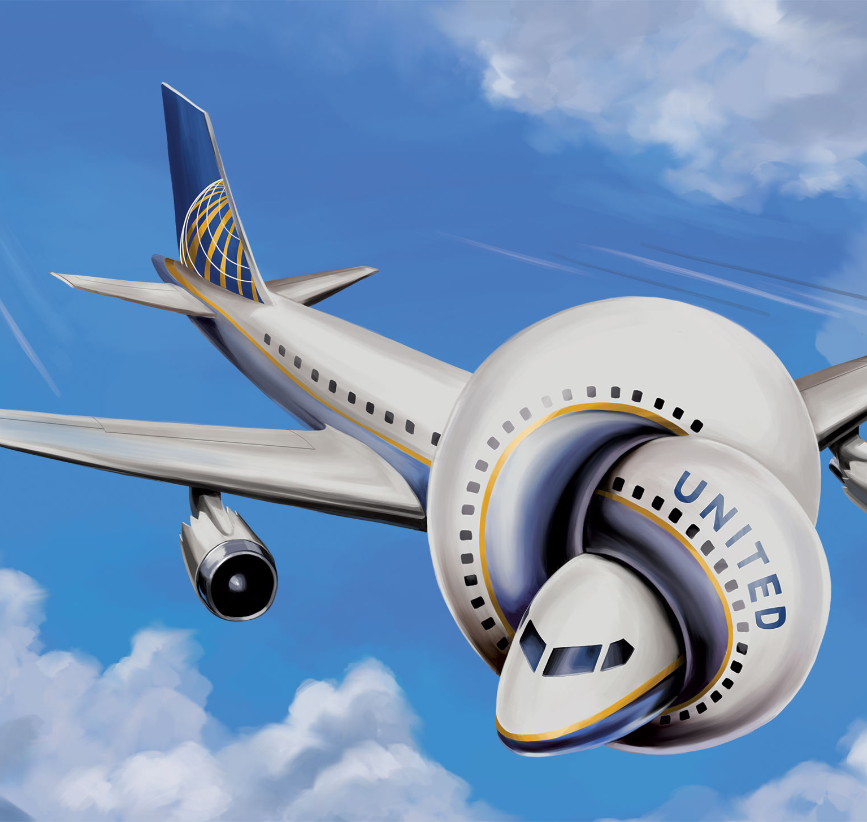
Key issues
~32% of the total issue is because of the Customer Service issue, followed by late flight issues
Out of all Airline, United Airlines is the worst airlines with the highest number of negative reviews (~29%) followed by southwest and united.
US Airways has the highest number of negative customer service reviews which is 29% of total negative customer reviews.
45% of negative tweets are from repeatedly unsatisfied customer
Virgin America is the most successful airlines with only 2% of total negative reviews.

Slide 5
Negative comment Categories

Slide 6
Airlines Reviews
Key metrics
Airline Reason | Negative Reason Count
Virgin America | 2%
Delta | 10%
Southwest | 13%
American | 21%
US Airways | 25%
United | 29%

Slide 7
Airlines Reviews
Key metrics
Customer Service Issue | 30%
Late Flight | 23%
Lost Luggage | 12%
Bad Flight | 10%
Cancelled Flight | 8%
Flight Attendant Complaints | 7%
Flight Booking Problems | 6%
longlines | 2%
Damaged Luggage | 1%

Slide 8



Market summary
Customer support is more popular now than ever, that creates first impression on customers generates positive trends among customers
Negative trends will continue rising based on projections, which provides an opportunity for greater business reach in this Airline Industry.
Focus more on providing Best support and our Airline will continue to rise and generate revenue.

Slide 9
Thank you
Team - A​
teams@freefall.com
www.freefall.com

